Slide 1
Tìm hiểu Matlab Simscape Multibody và ứng dụng trong mô phỏng hệ thống lái EPS

Slide 2
Plan
Week 1 : Introduction
Week 2 : Theoretical basis of EPS system and build the basic model for this system
Week 3 : Build mechanical model of steering system on Simulink.
Week 4 : Build a functional block to get the necessary output of the system
Week 5 : Keep researching basis theory and build model
Week 6: Combine with the rest of system
Week 7: Complete whole system and show the result from simulation
Week 8: Review, (finish outline, poster) and complete the project’s report
Now we are at week 8.

Slide 3
Introduction
Genre: Research project
Main working object: Electric Power Steering System
Implementation goal : Simulate an EPS sub-system
Limit of project.

Slide 4
Numerical simulation method
Simulation objectives & Result parameters to be achieved.
Theoretical basis : physical model.
The assumptions and mathematical models are selected for each process.
The process of performing simulation on the computer.
Calculation process on computer.
Methods of processing and analyzing simulation data.
Analyze and evaluate the reasonableness of simulation results.
Results and comments.

Slide 5
Report contain:
A summary of the theoretical basis
01
The contents performed by the students and the results achieved.
02
Detailed theoretical contents should be included in the appendix.
03

Slide 6

What is in Poster ?
Describe the problem
Solution method
Implementation content
Achieved results.

Slide 7

Learn to use MATLAB with some simple examples

Slide 8
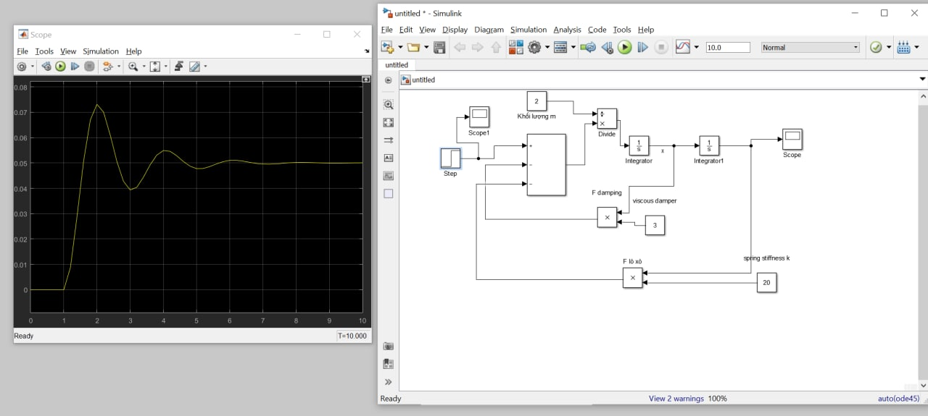
Result and model in use

Slide 9
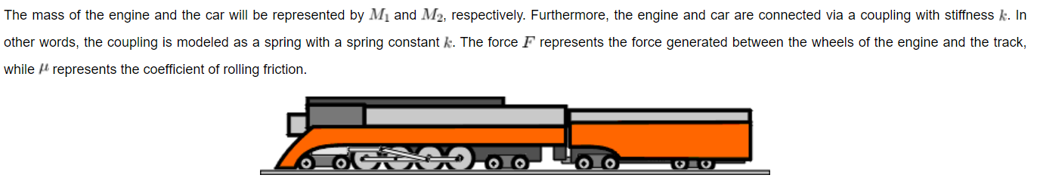
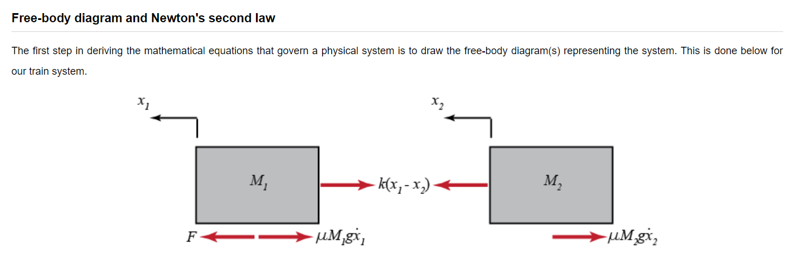
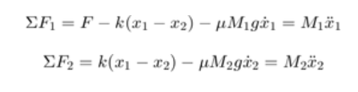
2. Train system

Slide 10
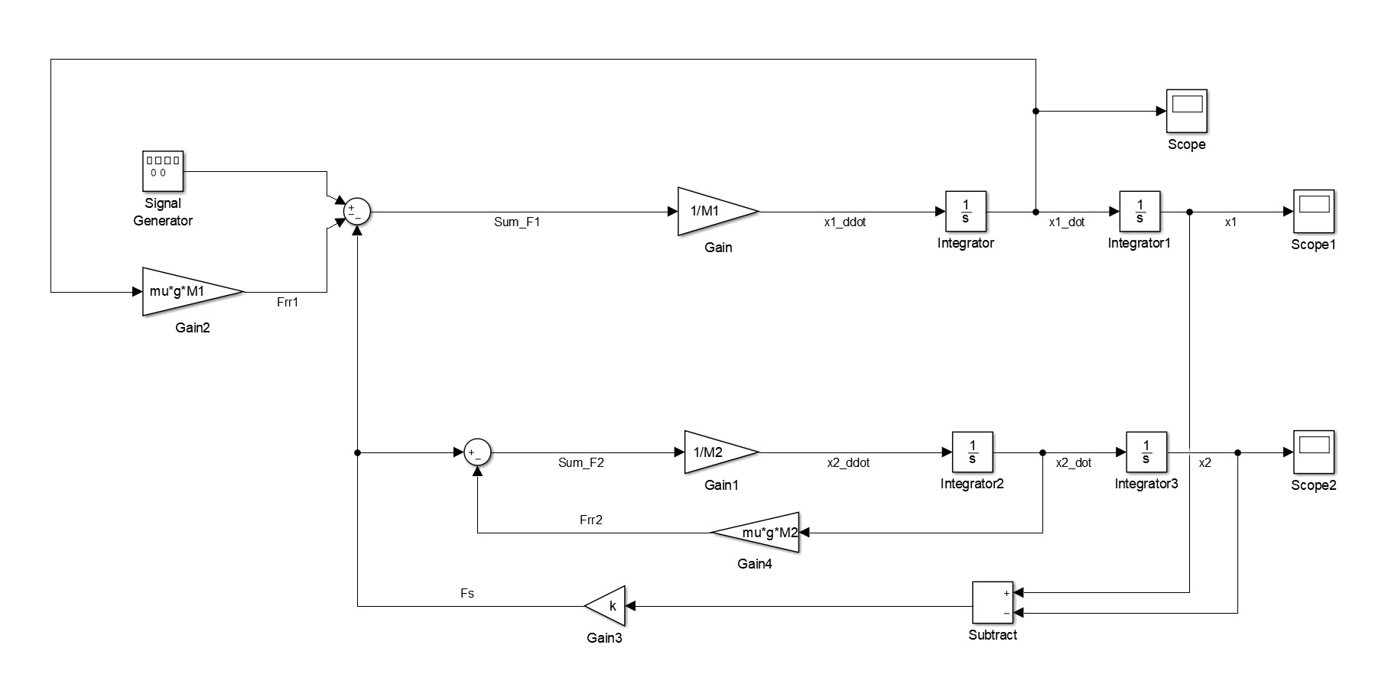
Model for train system

Slide 11
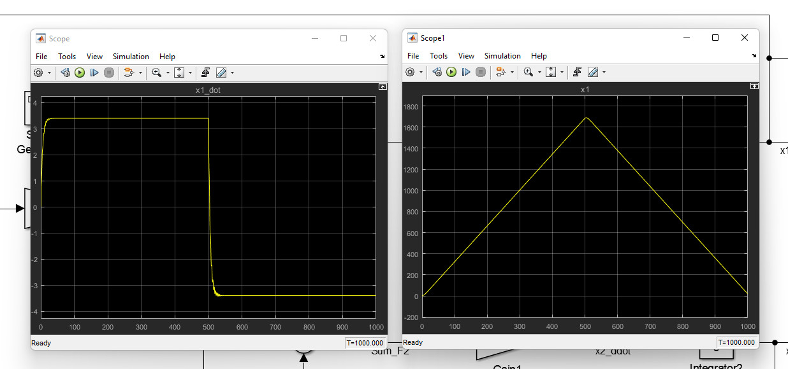
Result

Slide 12
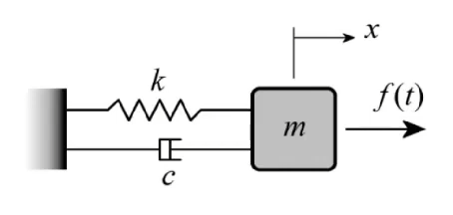
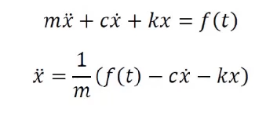
3. Mass and damper system analysis

Slide 13
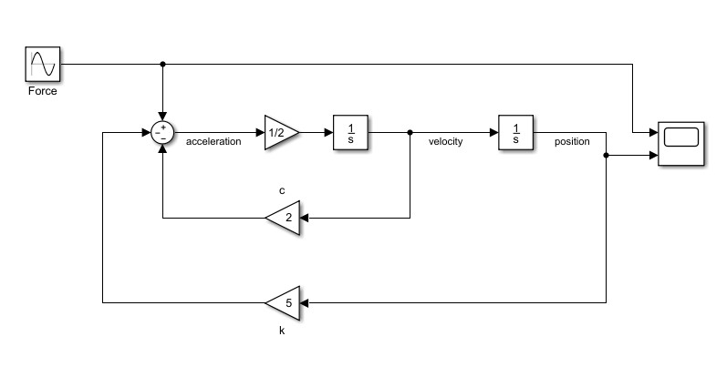
MATLAB/Simulink Simulation

Slide 14
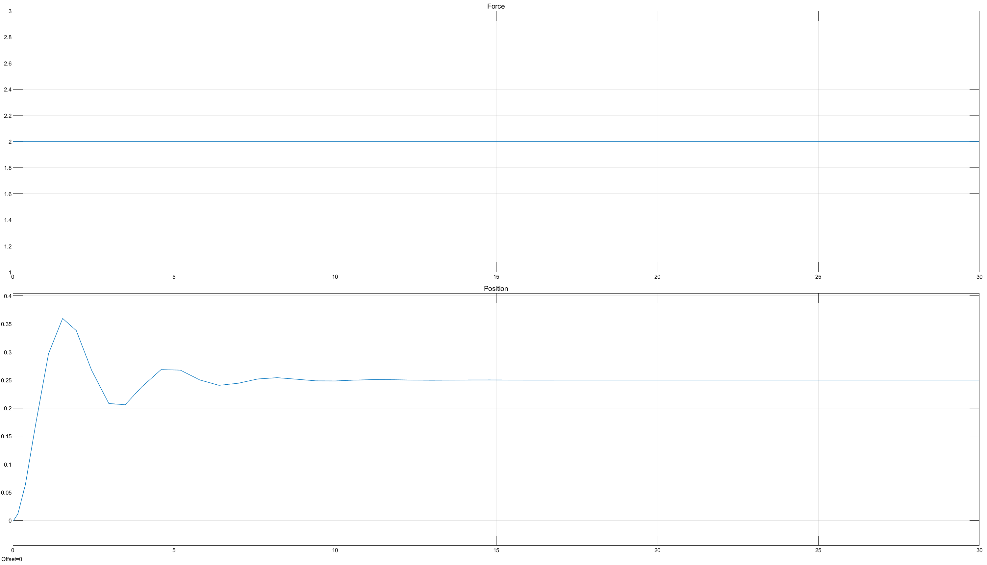
F= 2N ; m= 2kg ; c= 2N.s/m ; k = 8 N/m

Slide 15
Theory basis of Steering system

Slide 16
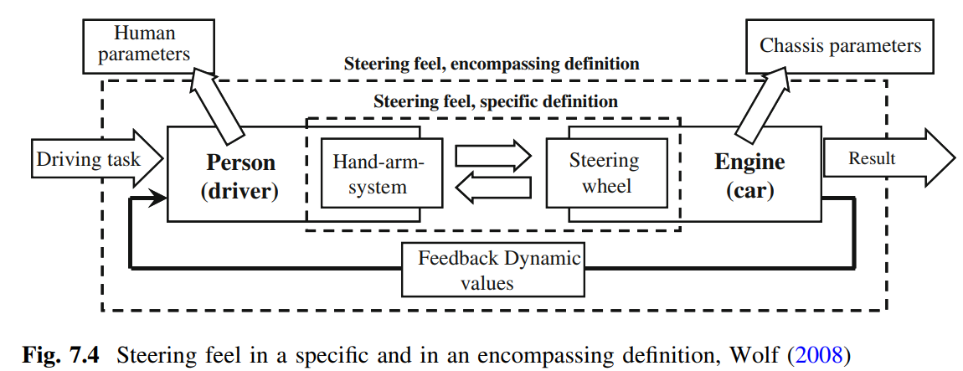
Notes:
INPUT OUTPUT

Slide 17
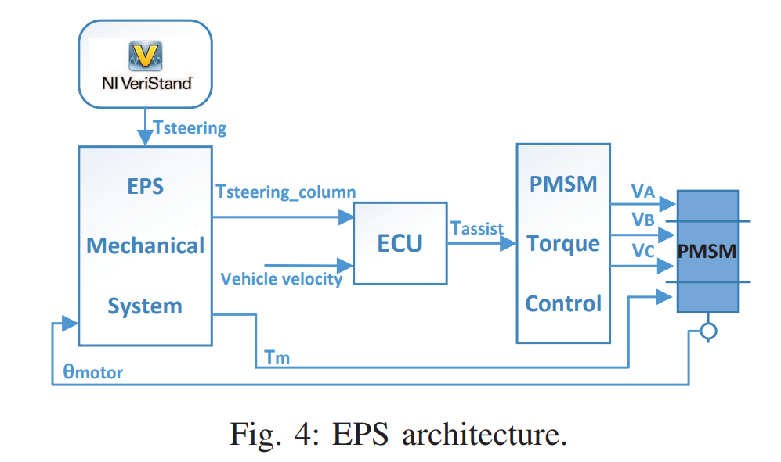

Slide 18
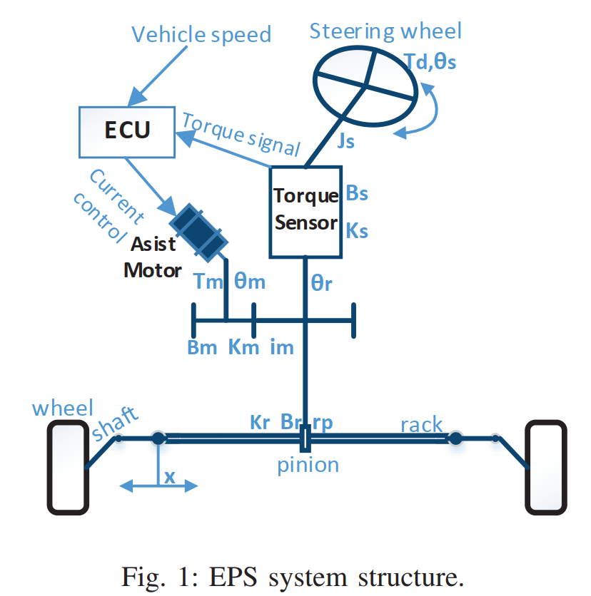

Slide 19
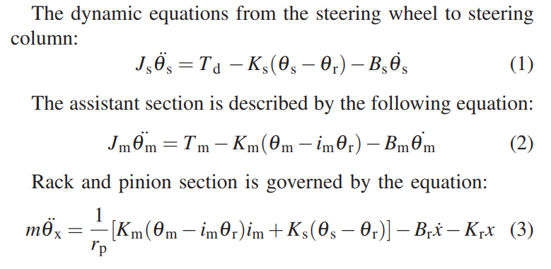
Equation
Notes:
Sửa phương trình lại, bỏ B và K

Slide 20

Equation
Dynamic equations from steering wheel to steering column:
$$J_{s}{\ddot{θ}}_{s}=T_{d}−K_{S}\left(θ_{S}−θ_{r}\right)−B_{s}{\dot{θ}}_{s}$$
Rack and Pinion section:
$$m\ddot{x}=\frac{K_{S}}{r_{P}}(θ_{S}−θ_{r})$$

Slide 21
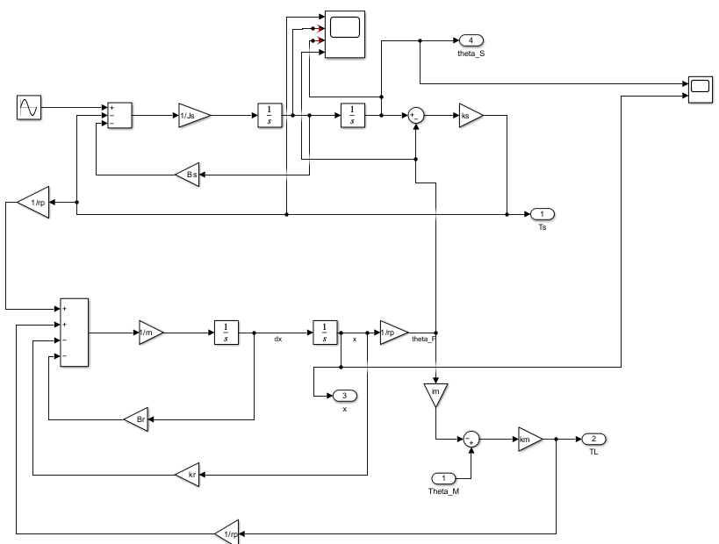
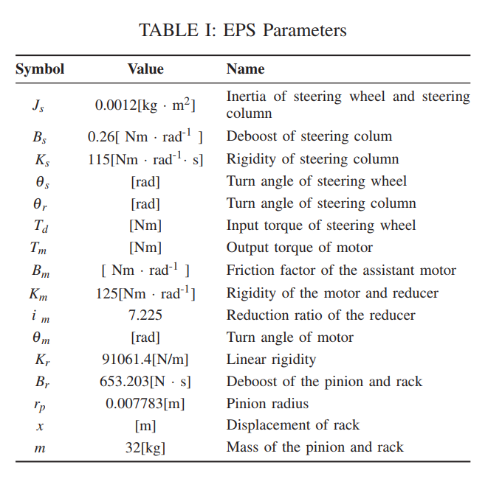

EPS DYNAMICS MODEL
Notes:
Sửa model lại, bỏ B và K

Slide 22
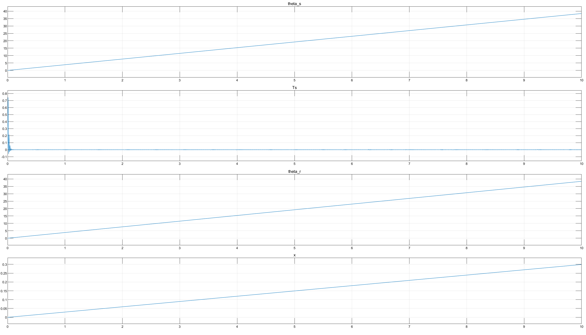

Slide 23
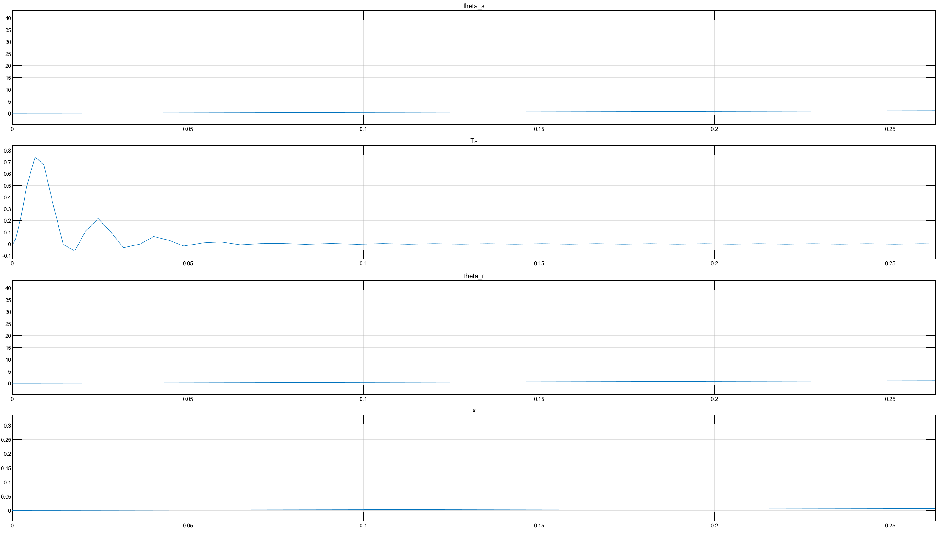

Slide 24
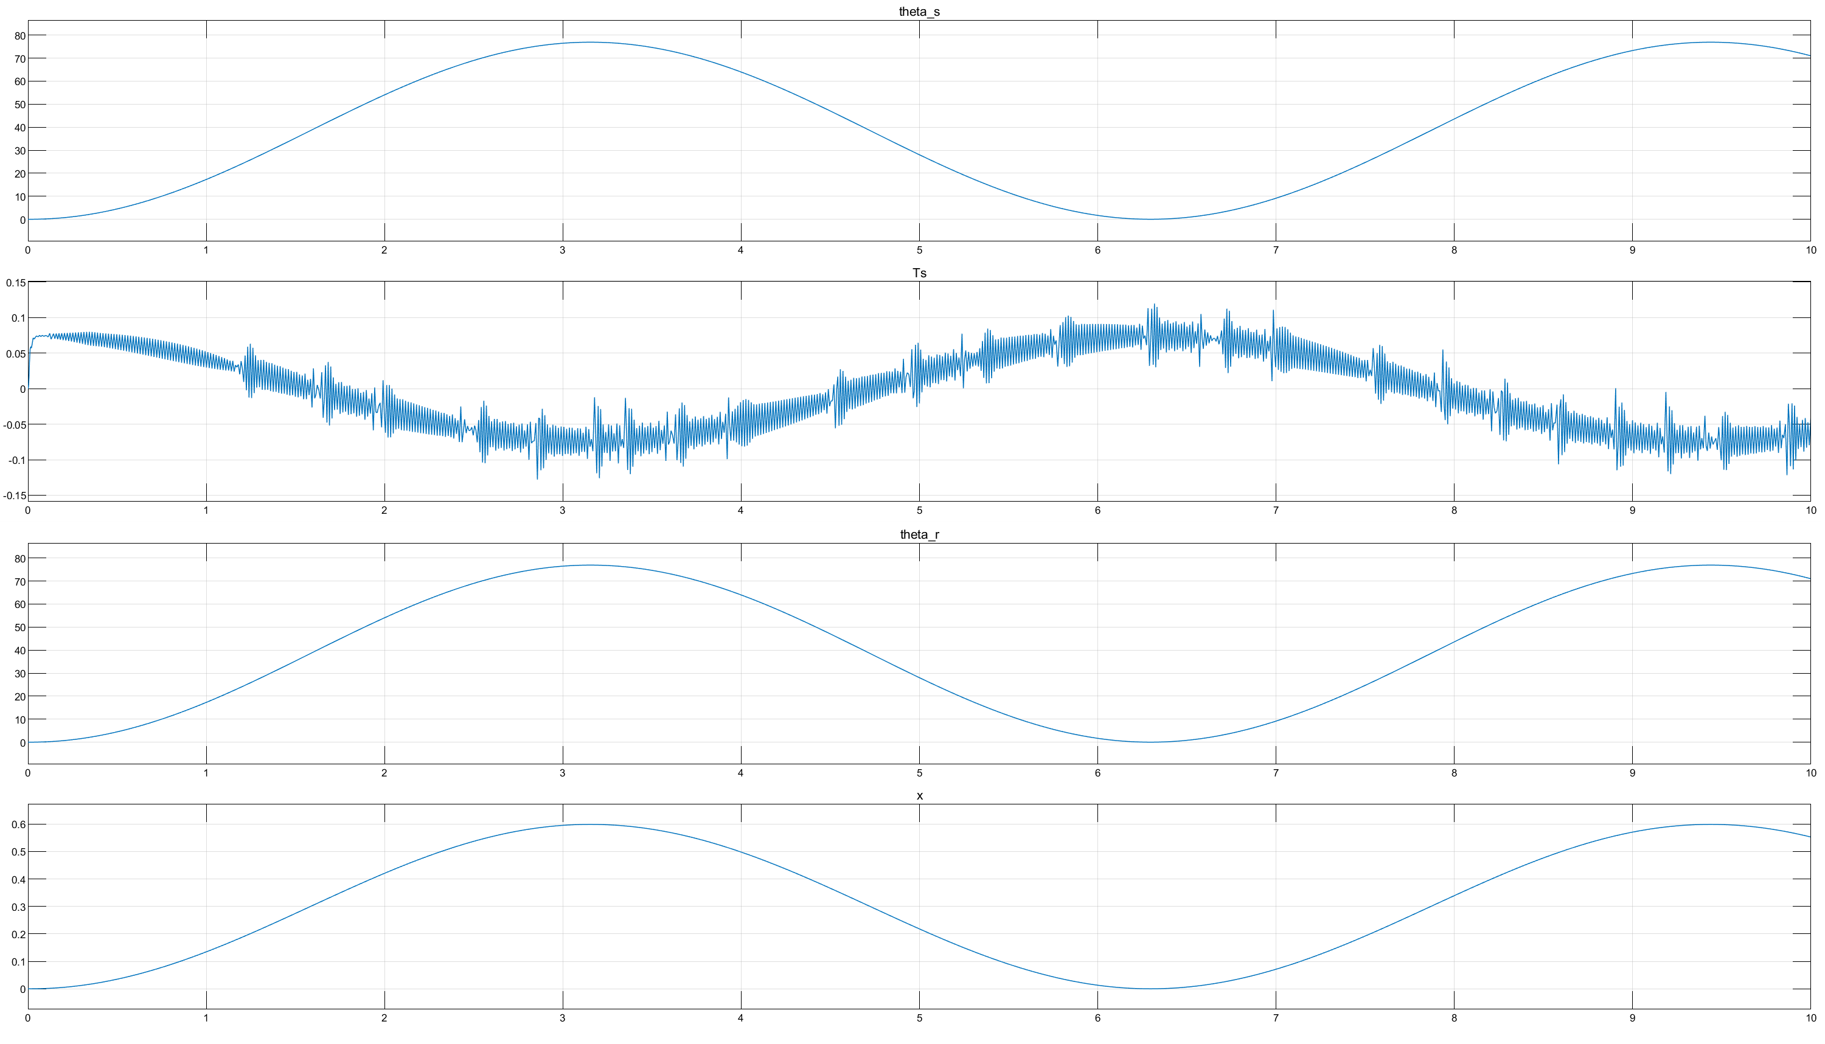

Slide 25
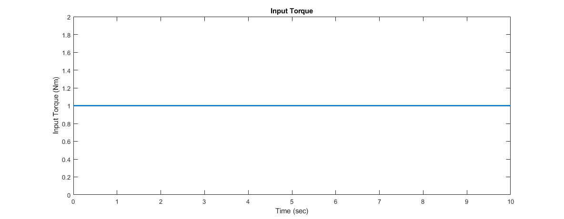
Input Torque

Slide 26
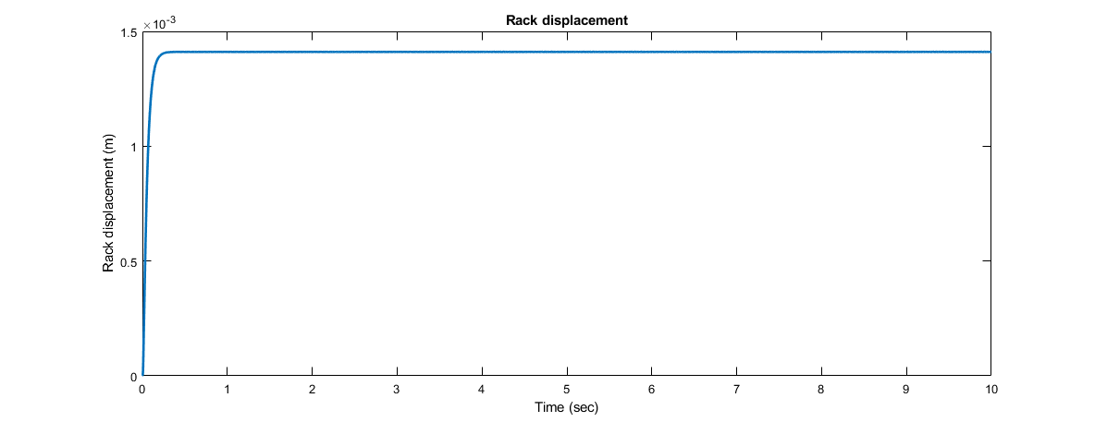
Rack displacement

Slide 27
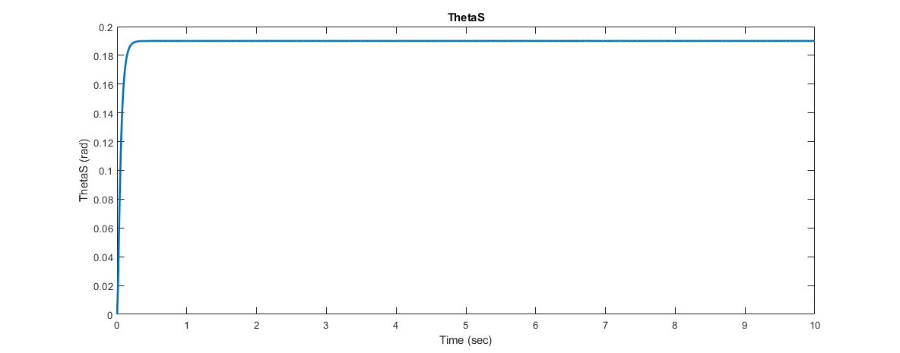
Theta S

Slide 28
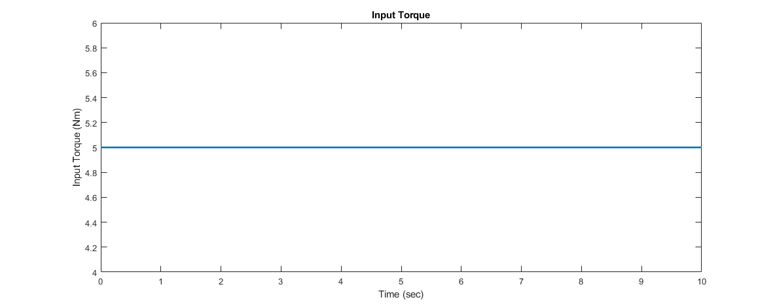
Input Torque

Slide 29
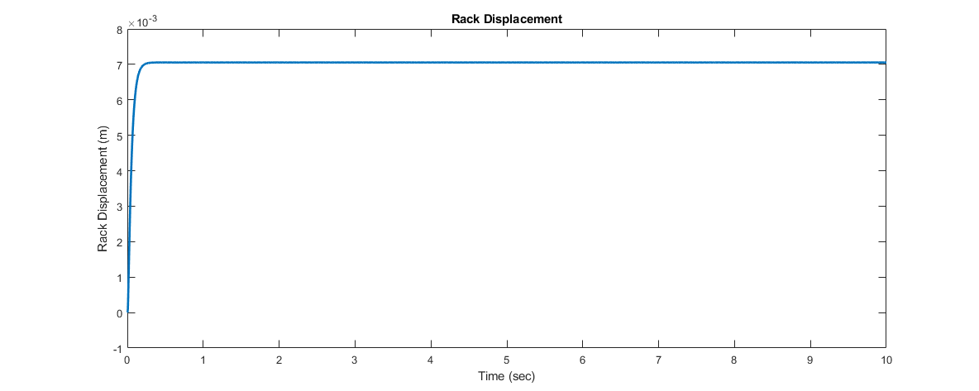
Rack displacement

Slide 30
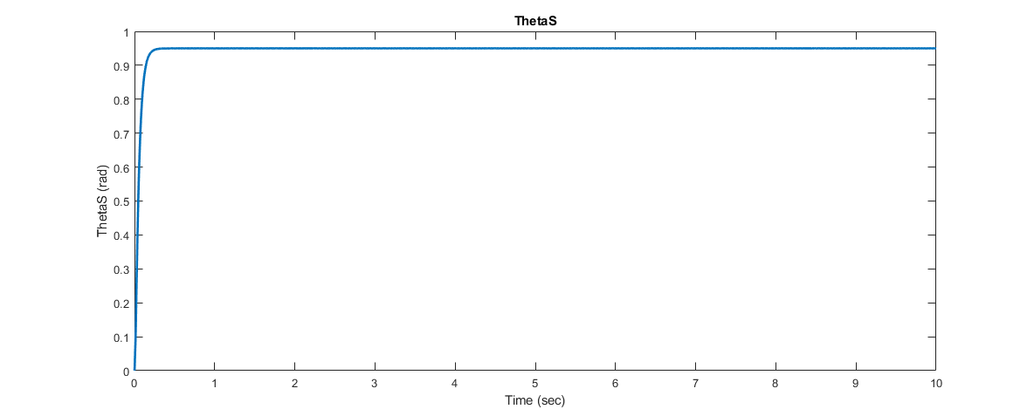
Theta S

Slide 31
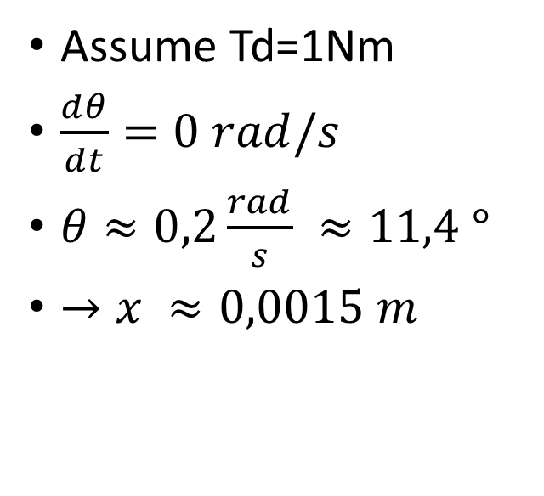
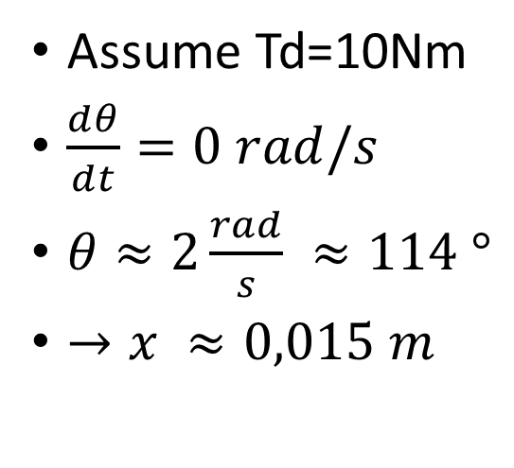
Calculation by using equation
Assume Td=10Nm
$\frac{ⅆθ}{ⅆt}=0 rad/s$
$θ≈2\frac{rad}{s} ≈114 °$
$→x ≈0,015 m$
Assume Td=1Nm
$\frac{ⅆθ}{ⅆt}=0 rad/s$
$θ≈0,2\frac{rad}{s} ≈11,4 °$
$→x ≈0,0015 m$

Slide 32
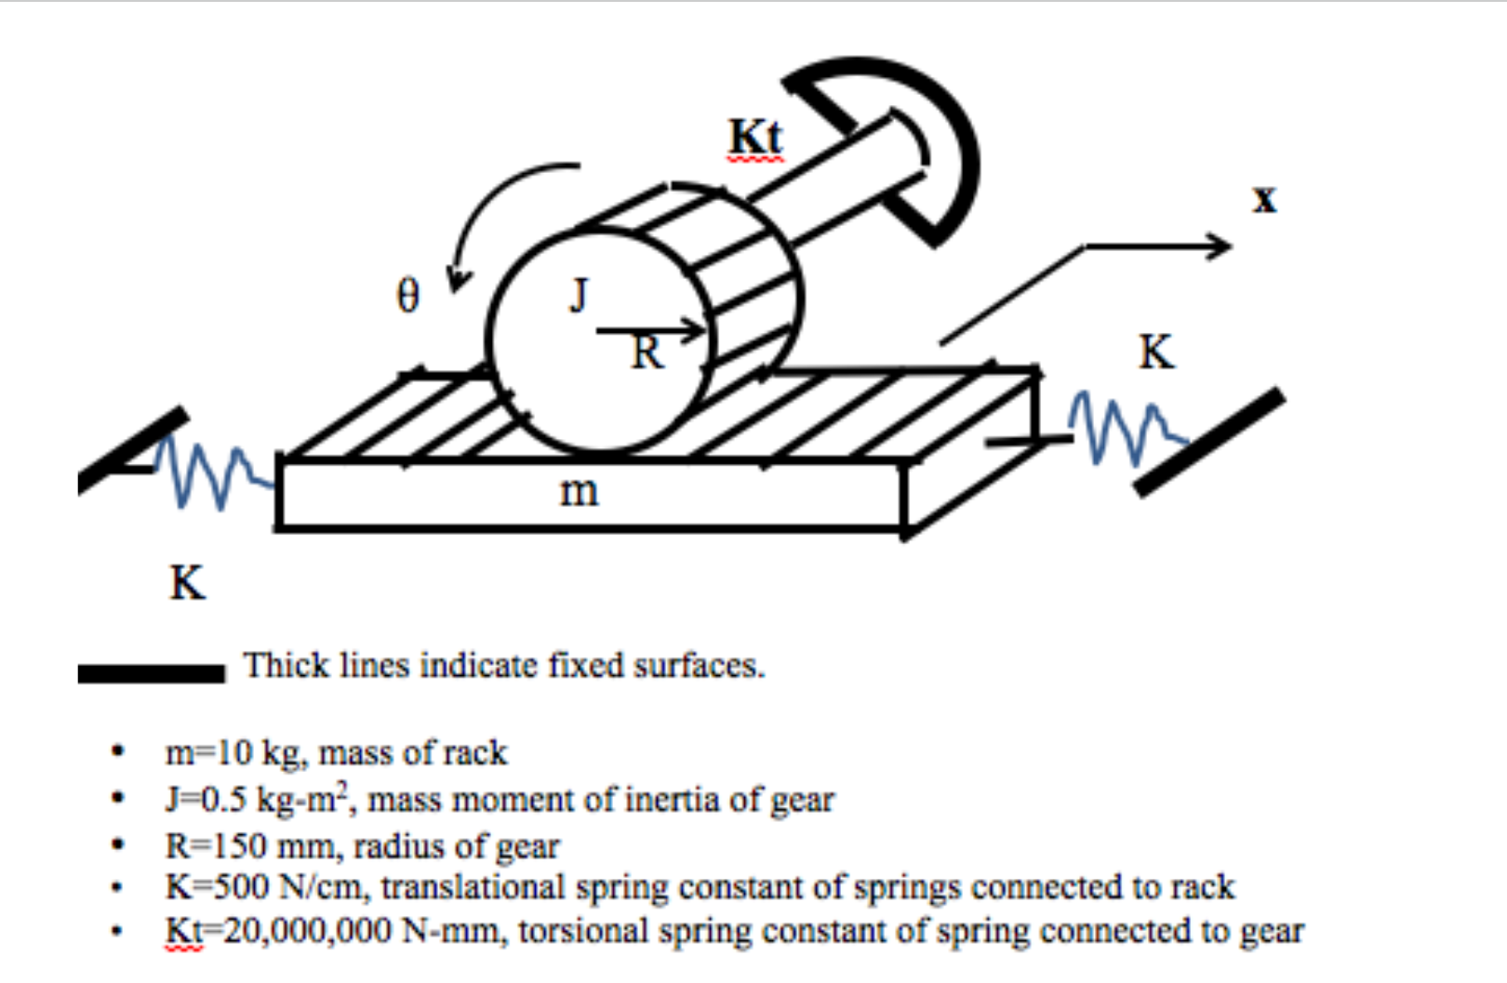
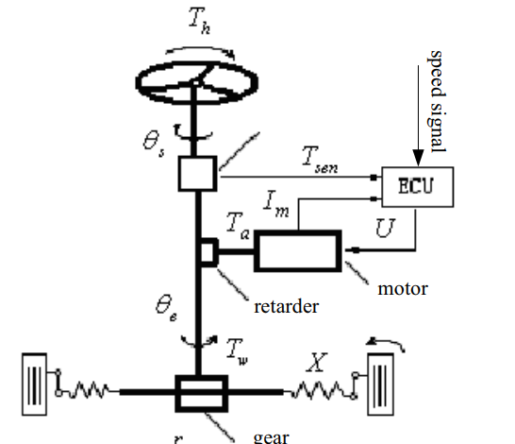
Rack Model Our model

Slide 33
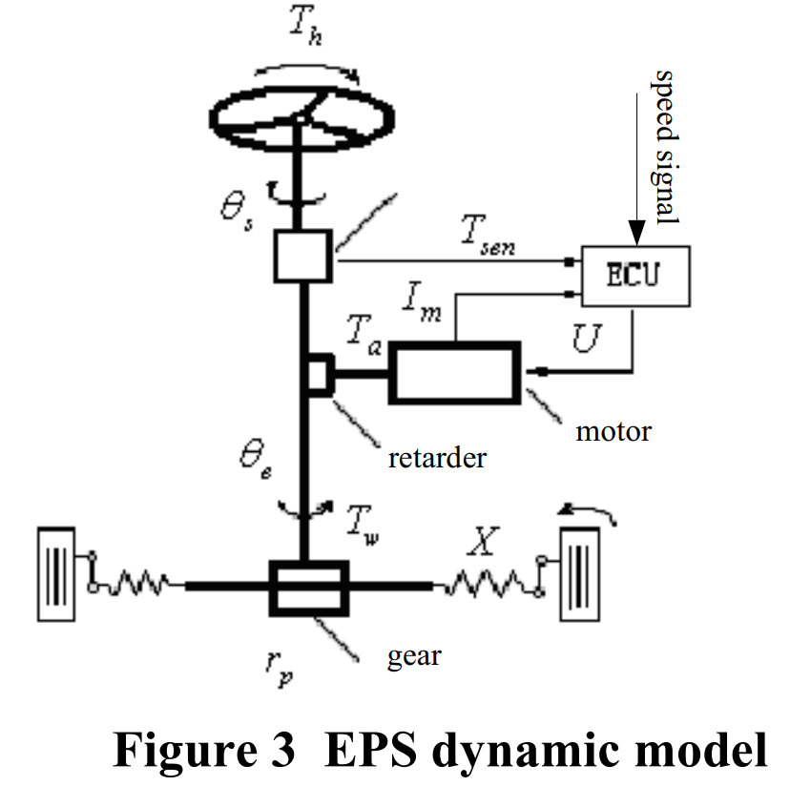
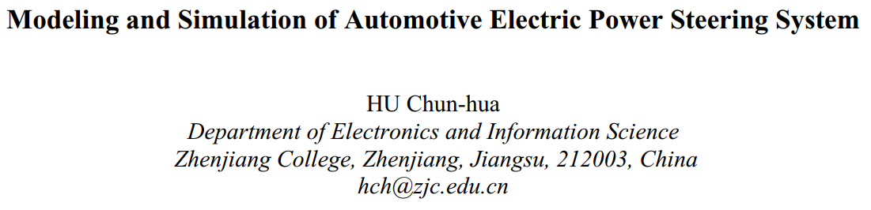
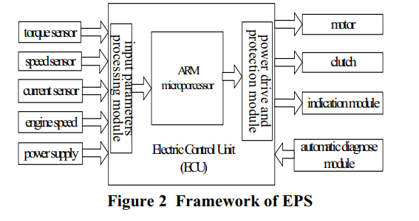
Another EPS paper

Slide 34
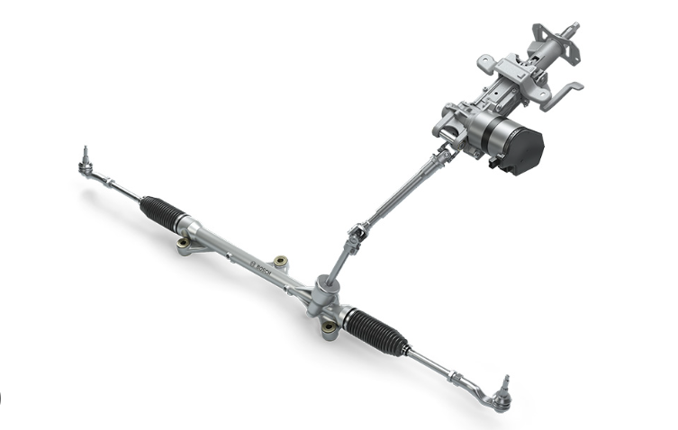
Model
Kr
rp
Br

Slide 35
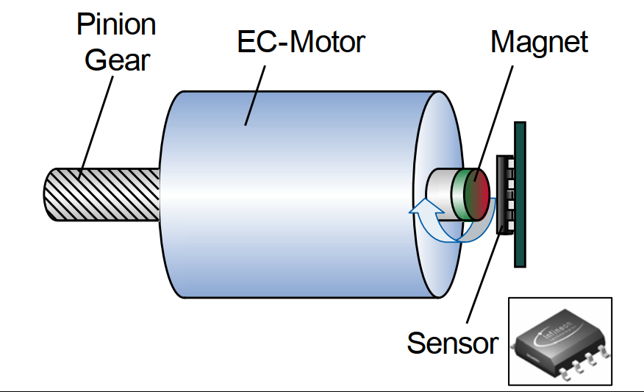
Km
Tm
Bm
im

Slide 36
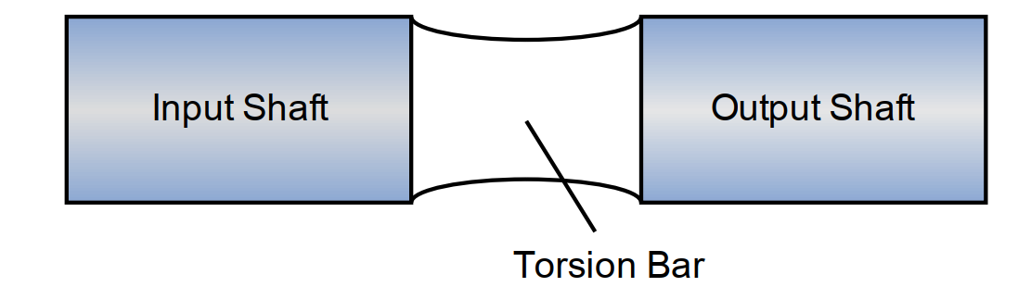
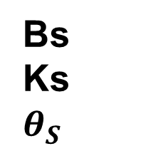
Bs
Ks
$$θ_{S}$$
$$θ_{r}$$

Slide 37

Force acting to steering wheel
Force need to steer the wheel is largest when vehicle is not moving (v=0km/h). In this situation, Restraint Rotational Moments include frictional moment M₁, Yaw moment M₂ , Stability moment cause by caster angle M₃.
While M₁ = G_{bx} .f.c
With G_{bx}: gravitational force acting on wheels
f – rolling friction coefficient: f = 0,015,
c – length from contact point to caster axle

Slide 38
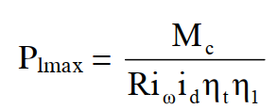
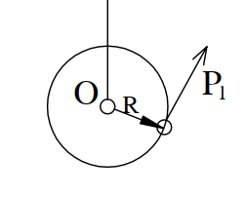
Force acting to steering wheel
While M₂ = Y_{x} = 0,14.G_{bx}ϕ₁.r
With ϕ1 – tire lateral traction coefficient ϕ₁ = 0,85
We get maximum force acting on steering wheel
η₁, η_{t} : is efficiency of transferring moment from wheel to steering wheel, η_{1.} η_{t} = 0,5 – 0,7
i_{ω}. I_{d} is transmission ratio, 24:1 with manual steering to about 14:1 with power steering assist.

Slide 39
Reference
Cossalter, V. (2010). Motorcycle Dynamics. Lulu.
Genta. (2020). The automotive chassis. Springer International Publishing.
Hiremath, R. R., & Isha, T. B. (2019). Modelling and simulation of electric power steering system using permanent magnet synchronous motor. IOP Conference Series: Materials Science and Engineering, 561(1), 012124. https://doi.org/10.1088/1757-899x/561/1/012124
Jazar, R. N. (2008). Vehicle dynamics: Theory and applications. Springer.
Nasir, M. Z., Dwijotomo, A., Abdullah, M. A., Hassan, M. Z., & Hudha, K. (2012). Hardware-in-the-loop simulation for automatic rack and pinion steering system. Applied Mechanics and Materials, 229-231, 2135–2139. https://doi.org/10.4028/www.scientific.net/amm.229-231.2135
Nemes, R.-O., Ruba, M., & Martis, C. (2018). Integration of real-time electric power steering system MATLAB/Simulink model into National Instruments Veristand Environment. 2018 IEEE 18th International Power Electronics and Motion Control Conference (PEMC). https://doi.org/10.1109/epepemc.2018.8521888
Pacejka, H. B. (2002). Tyres and vehicle dynamics. Butterworth-Heinemann.
Qun, Z., & Juhua, H. (2009). Modeling and simulation of the Electric Power Steering System. 2009 Pacific-Asia Conference on Circuits, Communications and Systems. https://doi.org/10.1109/paccs.2009.67
Notes:
Cossalter, V. (2010). Motorcycle Dynamics. Lulu.
Genta. (2020). The automotive chassis. Springer International Publishing.
Hiremath, R. R., & Isha, T. B. (2019). Modelling and simulation of electric power steering system using permanent magnet synchronous motor. IOP Conference Series: Materials Science and Engineering, 561(1), 012124. https://doi.org/10.1088/1757-899x/561/1/012124
Jazar, R. N. (2008). Vehicle dynamics: Theory and applications. Springer.
Nasir, M. Z., Dwijotomo, A., Abdullah, M. A., Hassan, M. Z., & Hudha, K. (2012). Hardware-in-the-loop simulation for automatic rack and pinion steering system. Applied Mechanics and Materials, 229-231, 2135–2139. https://doi.org/10.4028/www.scientific.net/amm.229-231.2135
Nemes, R.-O., Ruba, M., & Martis, C. (2018). Integration of real-time electric power steering system MATLAB/Simulink model into National Instruments Veristand Environment. 2018 IEEE 18th International Power Electronics and Motion Control Conference (PEMC). https://doi.org/10.1109/epepemc.2018.8521888
Pacejka, H. B. (2002). Tyres and vehicle dynamics. Butterworth-Heinemann.
Qun, Z., & Juhua, H. (2009). Modeling and simulation of the Electric Power Steering System. 2009 Pacific-Asia Conference on Circuits, Communications and Systems. https://doi.org/10.1109/paccs.2009.67

